Slide 1
Symphony of the Scriptures
Titus

Slide 2
Titus
64-67
A.D.
“But as for you, proclaim the things which are fitting for sound doctrine.”
(Tit. 2:1)
Taking Charge
Giving Advice
Doing Right
Conclusion (3:12-15)
Introduction (1:1-4)
Elders
Rebellious People
Older men and women
Young women & men
Leaders
Slaves & Masters
What to do
What not to do
Chapter 1
Chapter 2
Chapter 3
People
Elders Enemies
Specific Groups
Christians in general
Instruction for
particular people
Attitude and conduct
toward good and bad
Issue
Elders Qualifications
A church
…in good order (1:5)
…w/good doctrine (2:1)
…of good deeds (3:1)
Theme
Right living through sound doctrine
Key Verses
1:5; 2:10; 3:8
Notes:
One of the “sons of faith” (the other was Timothy), Titus was far less known but just as important in his work as an evangelist. He was a converted Greek (Gentile) who, unlike Timothy, was not compelled to be circumcised (Gal. 2:3). Although never mentioned by Luke in the book of Acts, the inferences are strong that he accompanied Paul on his third missionary journey and was obviously instrumental in working with Paul in establishing churches on the island of Crete. His name is mentioned some thirteen times in Paul’s epistles. Titus met with challenges in the churches in the area and Paul supplies help with this short letter that bears his name. He is referred to as his “true child in a common faith” (1:4). On three different occasions he is sent by Paul to the church at Corinth. We know he is left at Crete to carry out the work at churches that had been planted there (1:5). Paul spoke of him as his “brother” (2 Cor. 2:13), his “partner and fellow worker” (2 Cor. 8:23), and his “son” (Tit. 1:4). He lauded Titus’s character and conduct in 2 Corinthians 7:13-15; 8:16-17. It is believed that sometime after Paul’s first imprisonment in Rome that he spread the gospel in Crete and left Titus there to solidify the churches that had been established. The time and place where Paul wrote the letter is unknown but most argue that the letter was written from Macedonia after the first letter to Timothy. The churches in Crete were challenged and Paul seems to agree with a poet who says “Cretans are always liars, evil beasts, lazy gluttons” (Tit. 1:12). How would you like to live in a city like that? With this as background, no wonder Paul would write a letter to the young evangelist encouraging the churches to organize and practice sound doctrine (2:1). One cannot help but see the comparisons to Timothy with similar instruction. The letters to Titus and Timothy are similar in date, style and purposes. Both deal with the need for sound doctrine and contain encouragement to rebuke false teachers and practice good conduct. This short letter is easily outlined: chapter 1 deals with the need for sound leadership (elders) and opposing error; chapter 2 deals directly with conduct on how to live - be holy; chapter 3 emphasizes the need of practicing good deeds - holy is as holy does.
Application
Older Christians can adorn the doctrine (2:1) --- both men and women --- and have an obligation to teach the younger (2:2-4). Old age is not a time for retirement from the work in the Lord; there is always work to do (1 Cor. 15:58).
The world tells us that young men (and women) need to “sow their wild oats” and “get it out of their system”; but Paul said in 2:6, they need to be “sensible” (NASV),“self-controlled” (ESV) or “sober-minded” (KJV). Paul exhorts young Titus, “Show yourself in all respects to be a model of good works…” (2:8).
There is no greater subject than the grace of God (2:11-15): God’s active favor of providing the greatest gift upon those who deserve His greatest punishment. That said, we are to “renounce ungodliness and worldly passions, and to live self-controlled, upright, and godly lives in the present age” (2:12). Conduct matters! (See Ro. 6:1-2).
The phrase “be ready for every good deed (work)” does not mean “do a good deed, now and then.” Christians are to always be ready to serve…to do a good deed. We are “to show perfect courtesy toward all people” (3:2). When’s the last time you went out of your way to do a good deed for someone? Is this a normal practice for you, or an exception?
Key Thought: One might ask, “Why was it important for different groups in the church to live as they should?” Paul tells Titus, three things: (1) “…so that the word of God will not be dishonored” (2:5, NASV); (2) “…so that the opponent will be put to shame” (2:8, NASV); (3) “…so that they will adorn the doctrine of God our Savior in every respect” (2:10). Be it men or women, young or old, slaves or free…the objective is to practice sound doctrine (2:1) and apply it to our conduct, “to be obedient, to be ready for every good work” (3:1).

Slide 3
Period | History Covered | Scriptures | Years | Principal
Antediluvian | Creation to the Flood | Gen. 1-7 | 1656 | Adam
Postdiluvian | From the flood to call of Abraham | Gen. 8-!1 | 427 | Noah
Patriarchal | From the call of Abraham to Egyptian Bondage | Gen. 12-45 | 215 | Abraham
Egyptian Bondage | From Egyptian Bondage to the Exodus | Gen. 46-Ex. 11 | 215 | Joseph
Wilderness Wanderings | From Exodus to crossing of the Jordan | Ex. 12-Deut. 34 | 40 | Moses
Conquest of Canaan | From crossing of Jordan to Joshua’s death | Josh. 1-24 | 51 | Joshua
Judges | From Joshua to King Saul | Ju, Ruth, 1 Sa. 1-9 | 305 | Samuel
The United Kingdom | From origin of kingdom to its division | 1 Sa. 9-1 Ki. 11; 1 Chr. 10, 2 Chr. 9 | 120 | David
The Divided Kingdom | From the division to the fall of Israel | 1 Ki. 12-2 Ki. 20; 2 Chr. 10-32 | 253 | Elijah
Judah Alone | From fall of Israel to the fall of Judah | 2 Ki. 21-25; 2 Chr. 10-32 | 125 | Josiah
Babylonian Captivity | From the fall of Judah to the return | 2 Ki. 25-8- 21; Dan. 1-6; Ezekiel | 70 | Daniel, Ezekiel
Restoration of the Jews | From the return to end of OT history | Ezra, Nehemiah | 92 | Ezra
Between the Testaments | From end of OT to the beginning of the NT | None | 400 | Judas Maccabee
Life of Christ | From birth of Jesus to ascension | Mt-Jhn 21; Acts1 | 34 | Jesus
The Church | From ascension to death of John (96 AD approx.) | Acts 2-Revelation | 70 | Paul

Slide 4
Matthew
Mark
Luke
John
Acts
Romans
1 Corinthians
2 Corinthians
Galatians
Ephesians
Philippians
Colossians
1 Thessalonians
2 Thessalonians
1 Timothy
2 Timothy
Titus
Philemon
Hebrews
James
1 Peter
2 Peter
1 John
2 John
3 John
Jude
Revelation
CHRONOLOGICAL
James 50 AD
Mark 50 AD
1 Thessalonians 52 AD
2 Thessalonians 52 AD
1 Corinthians 57 AD
2 Corinthians 57 AD
Galatians 58 AD
Romans 58 AD
Matthew 58 AD
Luke 58 AD
Acts 62 AD
Philippians 62 AD
Philemon 62 AD
Colossians 62 AD
Ephesians 62 AD
1 Peter 65 AD
2 Peter 67 AD
Jude 67 AD
Titus 67 AD
1 Timothy 67 AD
2 Timothy 68 AD
Hebrews 69 AD
John (Gospel) 85 AD
1 John 85 AD
2 John 85 AD
3 John 85 AD
Revelation 95 AD
CANON
*From Hester, Heart of NT History

Slide 5
About the New Testament “Canon”
The list of books which are recognized as inspired and authoritative.
FIVE DIVISIONS
Gospels (4)
Matthew
Mark
Luke
John
Acts (1)
Book of History
Letters of Paul (13)
Thessalonians (2)
Corinthians (2)
Romans
Galatians
Philippians
Philemon
Ephesians
Colossians
Timothy (2)
Titus
General Letters (8)
James
1 & 2 Peter
1,2, 3 John
Jude
Hebrews
Apocalyptic (1)
Revelation

Slide 6
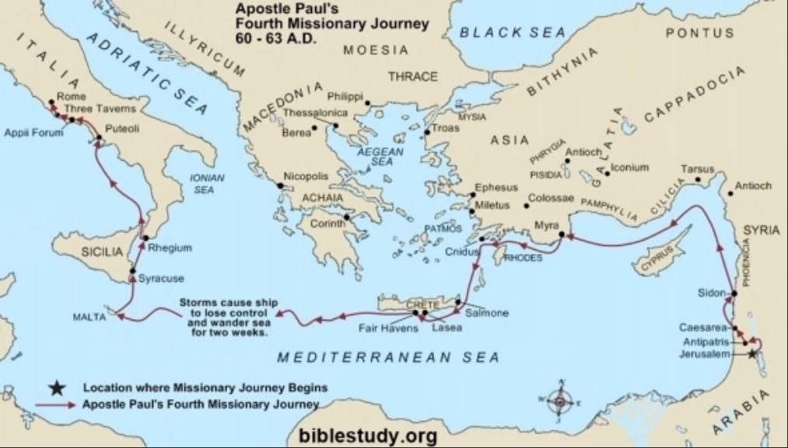

Slide 7
Approximate Chronology of Acts
Date
Chapter
Event
Letters Paul wrote
15:36-
18:22
SECOND MISSIONARY JOURNEY
Syria, Cilicia, Galatia, Troas, Philippi,
Thess, Berea, Athens, Corinth, Ephesus
FROM CORINTH
50-54
AD 52 - 1 Thessalonians
AD 53 - 2 Thessalonians
18:23-
21:17
THIRD MISSIONARY JOURNEY
Ephesus, Macedonia, Achaia,
Corinth, Philippi, Troas, Miletus
FROM EPHESUS
54-58
AD 56- 1 Corinthians
FROM MACEDONIA
AD 57 - 2 Corinthians
FROM CORINTH
AD 57 - Romans
AD 57 - Galatians
58
21:18-23
Arrest in Jerusalem
58-60
24-26
Imprisonment in Caesarea
60-61
27-28:16
Voyage to Rome
61-63
28:17-31
Paul’s imprisonment in Rome
FROM ROME
AD 62 - Colossians
AD 62 - Ephesians
AD - 62 Philippians
AD 62 - Philemon
---The Book of Acts Ends Here---
FROM MACEDONIA
AD 66 - 1 Timothy
AD 66 - Titus
63-66
Paul’s release from prison
66-67
FROM ROME
Second imprisonment in Rome
AD 66 - Hebrews (?)
AD 67 - 2 Timothy
68
Paul’s Martyrdom
*Taken from Harkrider Workbook Commentary on Acts - Book 1, page 4-5

Slide 8
Who wrote the book and to whom?
Paul identified himself as the author of the letter to Titus in the first verse, calling himself a “bond-servant of God and an apostle of Jesus Christ.”
In verse 4, he identifies he is writing “To Titus, a true son in our common faith.” The origin of Paul’s relationship with Titus is unknown. We know from Gal 2:3 that Titus was a Greek, and Paul called him “my partner and fellow worker” in 2 Cor. 8:23. Titus has been called by some ”the most enigmatic figure in early Christian history.”
When discussing Titus, one can see similarities between him and Timothy. Both were probably converted by Paul, as he calls them both “a true son of the faith” (1 Tim 1:2; Titus 1:4) but scholars assume he was a bit older:
He tells Timothy: “Let no one despise your youth,” (1 Tim 4:12)
He tells Titus to: “exhort the young men to be sober-minded” (Titus 2:6)
Paul clearly held Titus in a position of great respect as a friend and fellow worker for the gospel, praising Titus for his affection, his earnestness, and his bringing comfort to others.
Arguably, the letter was written not long after 1 Timothy, about 64-66 A.D.

Slide 9
Where are we?
We know that at some point Titus became a traveling companion of Paul’s. Galatians 2:1 tells us that Titus accompanied Paul and Barnabas when they went to Jerusalem to consult with Peter and James regarding the gospel they preached. This occurred before the 2nd missionary journey and maybe before the first. Although in Acts, Luke never mentions Titus as Paul’s travel companion, the term “we” probably includes Titus at least on the third missionary journey (Acts 16:9-13). Paul refers to Titus many times on his third journey, (2 Corinthians 2:12–13; 7:5–7, 13–15; 8:6, 16–24, 12:18) during which the apostle sent him to Corinth at least once.
The situation in Crete was discouraging. The government of the church needed to be set in order and the church needed to be grounded in sound doctrine. Paul counted on Titus in tough times and William Barclay characterized him as one who “will go with you in any kind of weather. We might also ask where Paul was when he wrote the letter. The answer is, ”We do not know.” While it is difficult to put a time on the letter, most assume it was written after 1 Timothy between Paul’s first and second imprisonment, possibly from Macedonia.

Slide 10
Why is Titus so important?
The churches on Crete were just as susceptible to false teachers as any other church, so Paul directed Titus to appoint elders to oversee the doctrinal purity and good conduct of the believers on Crete (1:5).
Paul exhorted Titus to “speak the things which are proper for sound doctrine” (Titus 2:1), a clear direction that this should be the primary role of evangelists. Paul understood that when a body of believers embraces sound doctrine, the result is changed and purified lives that produce “good works” (as mentioned in 2:7, 14; 3:8, 14).
Paul gave instructions to Titus about the roles of specific groups of people — older men, older women, young women, young men, and slaves — as well as general instructions to all believers about their conduct. Right living was essential because Christ “gave Himself for us to redeem us from every lawless deed” (Titus 2:14). How did He do this? “He saved us through the washing of regeneration and renewing of the Holy Spirit” (Titus 3:5).

Slide 11
What’s the point?
The appointment of elders is the subject of chapter 1, while chapters 2 and 3 are concerned with other matters that needed to be “set in order.” Paul also wrote to encourage Titus regarding the daunting task he faced and to back him up by giving him an authoritative apostolic letter. We are reading somebody else’s mail and Paul’s short letter is very personal in nature.
Some suggest that chapter 1 focuses on what was lacking in the church, while chapters 2 and 3 relate to what was lacking in society. In any event, ”setting things in order” was the point of the letter. For sure, Paul encouraged the rebuke of false teachers by saying true teachers are “holding fast the faithful word as he has been taught, that he may be able, by sound doctrine, both to exhort and convict those who contradict.” (Titus 1:9)
No preacher can be said to be preaching the word without “guarding the trust” (1 Tim 6:20). A primary fact about the letter to Titus is that it is intensely practical. Paul wanted Christians to understand that sound doctrine must be expressed in sound living. Thus, he admonished Titus:
Titus 3:8 “The saying is trustworthy, and I want you to insist on these things, so that those who have believed in God may be careful to devote themselves to good works. These things are excellent and profitable for people.”

Slide 12
How do I apply?
How seriously do you consider your beliefs about God in the overall scheme of your life? Can it be said of you that your source is sound doctrine? That you do all you can to promote sound doctrine? That you do all you can to stop those who teach false doctrine?
The book of Titus reminds us that our beliefs about God impact every decision we make. Sometimes it is difficult for believers today to see the point of getting all worked up about the person and nature of Christ or the doctrine of the Trinity. However, Paul made clear that a church that teaches and preaches sound doctrine will see results in the lives of its people. Not only will people be saved from their sins, but God’s grace will also motivate them to live out that saving faith with renewed and purified lives.
Many churches today focus more on the form of their worship—singing, lighting, and building designs—than they do on the content of the faith they mean to proclaim. Without a firm base of sound doctrine, the church will lay its foundation in shifting and sinking sand. Make doctrine a priority in your own life. Nothing is more significant than a solid foundation in Christ. Nothing is more motivational than grace to live a life of good deeds.

Slide 13
Places Paul said he visited after his release
from his first Roman imprisonment
Macedonia 1 Tim 1:3
Crete Titus 1:5
Nicopolis Titus 3:12
Ephesus 2 Tim 1:18
Troas 2 Tim 4:13
Corinth 2 Tim 4:20
Miletus 2 Tim 4:20
And, of course, he went to Rome again.

Slide 14
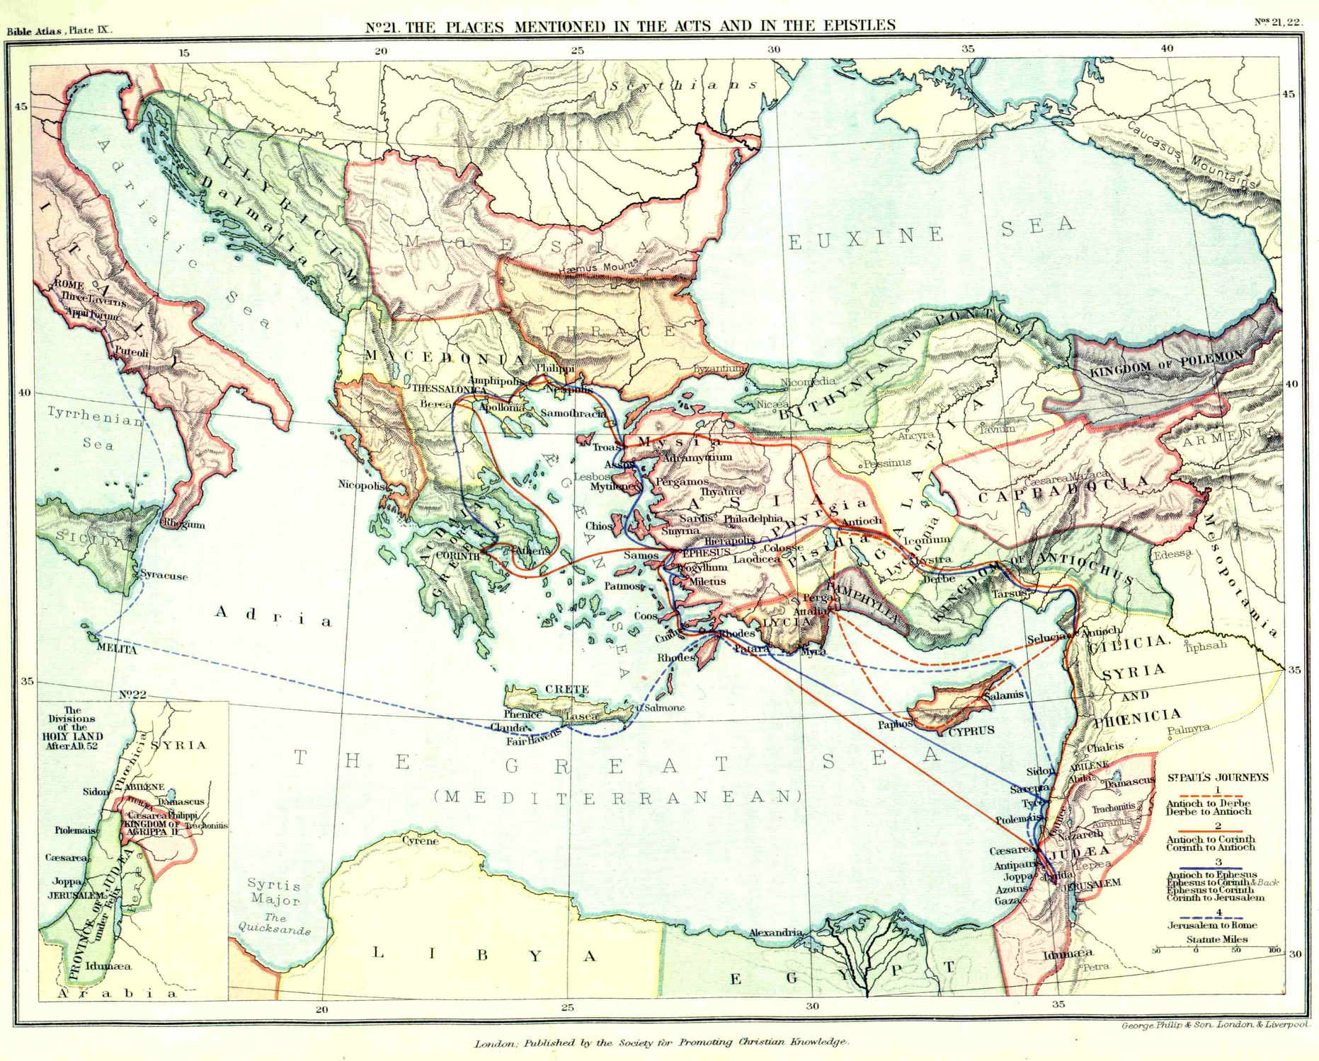

Slide 15
Titus
64-67
A.D.
“But as for you, proclaim the things which are fitting for sound doctrine.”
(Tit. 2:1)
Taking Charge
Giving Advice
Doing Right
Conclusion (3:12-15)
Introduction (1:1-4)
Elders
Rebellious People
Older men and women
Young women & men
Leaders
Slaves & Masters
What to do
What not to do
Chapter 1
Chapter 2
Chapter 3
People
Elders Enemies
Specific Groups
Christians in general
Instruction for
particular people
Attitude and conduct
toward good and bad
Issue
Elders Qualifications
A church
…in good order (1:5)
…w/good doctrine (2:1)
…of good deeds (3:1)
Theme
Right living through sound doctrine
Key Verses
1:5; 2:10; 3:8
Notes:
One of the “sons of faith” (the other was Timothy), Titus was far less known but just as important in his work as an evangelist. He was a converted Greek (Gentile) who, unlike Timothy, was not compelled to be circumcised (Gal. 2:3). Although never mentioned by Luke in the book of Acts, the inferences are strong that he accompanied Paul on his third missionary journey and was obviously instrumental in working with Paul in establishing churches on the island of Crete. His name is mentioned some thirteen times in Paul’s epistles. Titus met with challenges in the churches in the area and Paul supplies help with this short letter that bears his name. He is referred to as his “true child in a common faith” (1:4). On three different occasions he is sent by Paul to the church at Corinth. We know he is left at Crete to carry out the work at churches that had been planted there (1:5). Paul spoke of him as his “brother” (2 Cor. 2:13), his “partner and fellow worker” (2 Cor. 8:23), and his “son” (Tit. 1:4). He lauded Titus’s character and conduct in 2 Corinthians 7:13-15; 8:16-17. It is believed that sometime after Paul’s first imprisonment in Rome that he spread the gospel in Crete and left Titus there to solidify the churches that had been established. The time and place where Paul wrote the letter is unknown but most argue that the letter was written from Macedonia after the first letter to Timothy. The churches in Crete were challenged and Paul seems to agree with a poet who says “Cretans are always liars, evil beasts, lazy gluttons” (Tit. 1:12). How would you like to live in a city like that? With this as background, no wonder Paul would write a letter to the young evangelist encouraging the churches to organize and practice sound doctrine (2:1). One cannot help but see the comparisons to Timothy with similar instruction. The letters to Titus and Timothy are similar in date, style and purposes. Both deal with the need for sound doctrine and contain encouragement to rebuke false teachers and practice good conduct. This short letter is easily outlined: chapter 1 deals with the need for sound leadership (elders) and opposing error; chapter 2 deals directly with conduct on how to live - be holy; chapter 3 emphasizes the need of practicing good deeds - holy is as holy does.
Application
Older Christians can adorn the doctrine (2:1) --- both men and women --- and have an obligation to teach the younger (2:2-4). Old age is not a time for retirement from the work in the Lord; there is always work to do (1 Cor. 15:58).
The world tells us that young men (and women) need to “sow their wild oats” and “get it out of their system”; but Paul said in 2:6, they need to be “sensible” (NASV),“self-controlled” (ESV) or “sober-minded” (KJV). Paul exhorts young Titus, “Show yourself in all respects to be a model of good works…” (2:8).
There is no greater subject than the grace of God (2:11-15): God’s active favor of providing the greatest gift upon those who deserve His greatest punishment. That said, we are to “renounce ungodliness and worldly passions, and to live self-controlled, upright, and godly lives in the present age” (2:12). Conduct matters! (See Ro. 6:1-2).
The phrase “be ready for every good deed (work)” does not mean “do a good deed, now and then.” Christians are to always be ready to serve…to do a good deed. We are “to show perfect courtesy toward all people” (3:2). When’s the last time you went out of your way to do a good deed for someone? Is this a normal practice for you, or an exception?
Key Thought: One might ask, “Why was it important for different groups in the church to live as they should?” Paul tells Titus, three things: (1) “…so that the word of God will not be dishonored” (2:5, NASV); (2) “…so that the opponent will be put to shame” (2:8, NASV); (3) “…so that they will adorn the doctrine of God our Savior in every respect” (2:10). Be it men or women, young or old, slaves or free…the objective is to practice sound doctrine (2:1) and apply it to our conduct, “to be obedient, to be ready for every good work” (3:1).

Slide 16
Short Outline
Greeting (1:1-4)
Putting things in order by appointing elders (Chap 1:5-16)
Men who are strong Christian husbands and fathers should be selected as elders (1:5-9)
Men who are able to deal with false teachers should be selected as elders (1:10-16; see 3:9-11).
Putting things in order by emphasizing sound doctrine (Chap 2)
Sound doctrine commanded (2:1, 7, 8, 15).
Sound doctrine applied to all ages (2:2-8) and servants (2:9-10).
Sound doctrine explained (2:11-14)
Putting things in order by encouraging good deeds (Chap 3:1-8)
The need for good deeds (1:16; 2:7, 14).
As citizens (3:1-2)
As evangelists (3:8b, 14)
The motive for good deeds: God’s love (3:3-8).
Final Instructions (3:9-15)
Dealing with troublesome people (3:9-11)
Dealing with good men (3:12-14)
Concluding remarks (3:15)

Slide 17
Comparison of 1 Timothy and Titus
I. The qualification of elders
1 Tim 3:1-7 Titus 1:5-9
II. The need for sound doctrine
1 Tim 1:10; 4:6; 6:3 Titus 1:9; 2:1
III. False Teachers
1 Tim 1:3-11; 4:1-5; 6:3-5 Titus 2:2-6 IV. Relating to different age groups 1 Tim 5:1-2 Titus 2:2-6
V. The need to be a good example 1 Tim 4:12-16 Titus 2:6-8
VI. The conduct of slaves 1 Tim 6:1-2 Titus 2:9-10 VII. “Trustworthy statements” 1 Tim 1:15; 3;1; 4:8-9 Titus 3:4-5

